Slide 1
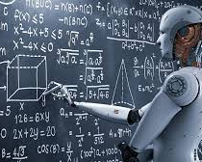
ai

Slide 2

Understanding Artificial Intelligence
Brief overview of AI, including machine learning (ML), deep learning, and neural networks
Examples of AI applications (voice assistants, recommendation systems, autonomous vehicles)
How AI processes data to learn and make predictions or decisions

Slide 3
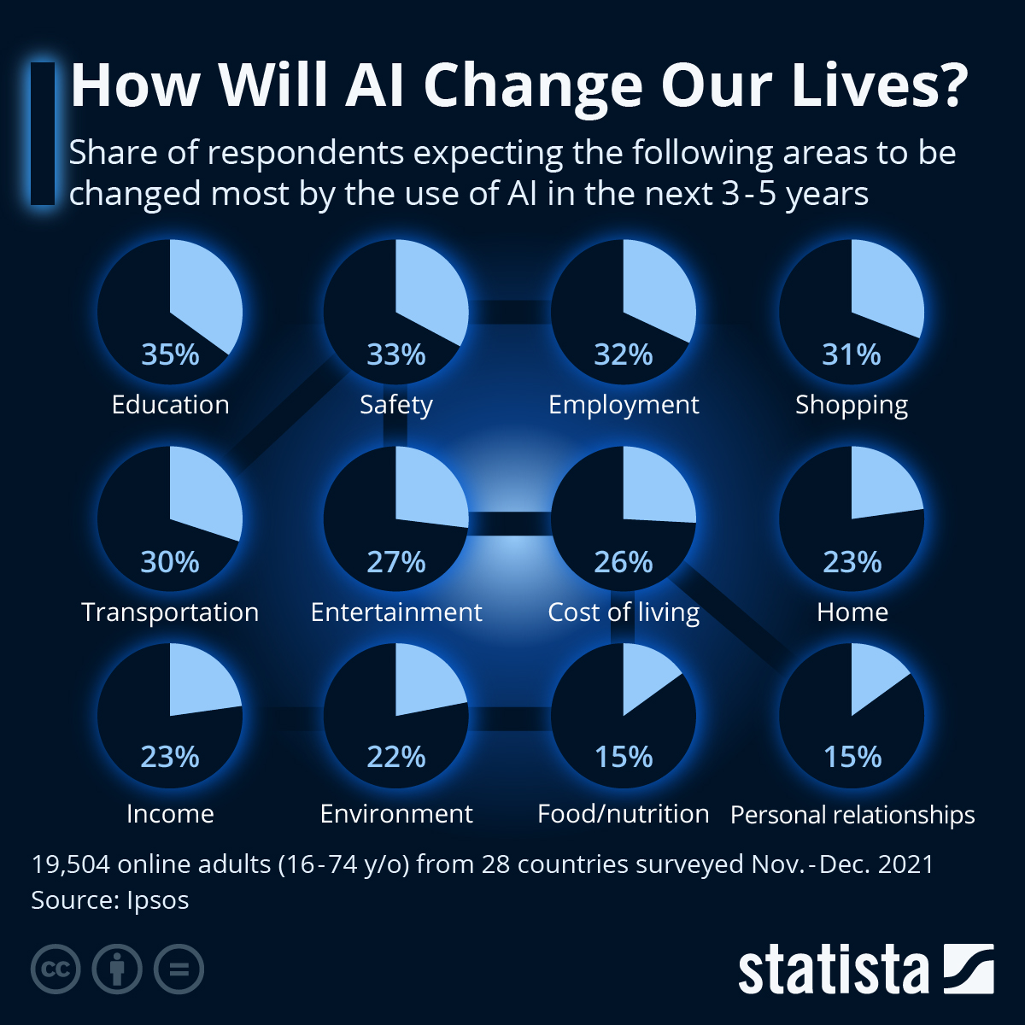

Slide 4
Huge spectrum, from Quantum computing with autonomous thinking to evolved search.
AI is a tough term
ChapGPT is evolved search, but has many issues, from privacy, security to IP issues, to how people are using this

Slide 5
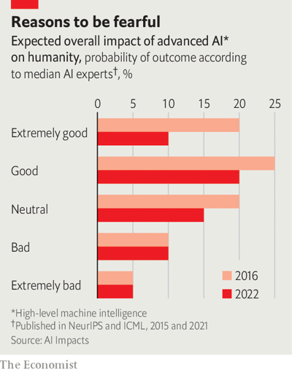

Slide 6
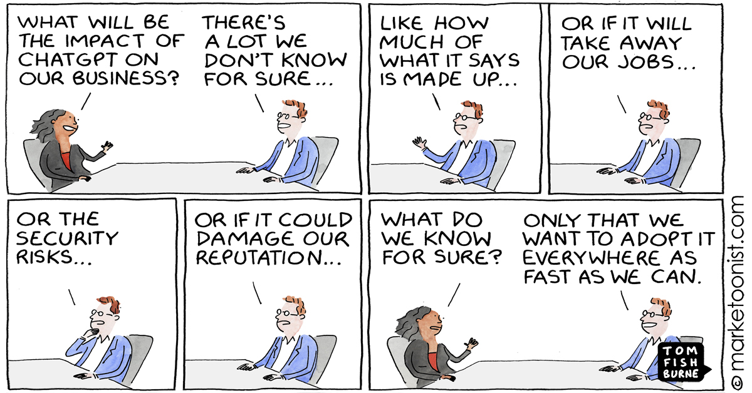

Slide 7

Definition of AI:
Artificial Intelligence (AI) refers to the simulation of human intelligence in machines that are programmed to think like humans and mimic their actions.
Types of AI:
Narrow AI: Also known as Weak AI, this type of AI is designed to perform a narrow task (e.g., facial recognition, internet searches, driving a car).
General AI: Also known as Strong AI, this type of AI would have a general understanding comparable to human intelligence, allowing it to perform any intellectual task.
Machine Learning: A subset of AI that includes algorithms that parse data, learn from it, and then apply what they've learned to make informed decisions.
Deep Learning: A subset of Machine Learning that uses neural networks with many layers (deep neural networks) to analyse large volumes of data, often for image and speech recognition.

Slide 8

Applications of AI:
Personal assistants like Siri and Alexa
Recommendation systems like those on Netflix and Amazon
Autonomous vehicles such as drones and self-driving cars
Benefits of AI:
Increases efficiency by automating routine tasks
Enhances decision-making by providing in-depth data analysis
Improves outcomes in sectors like finance, farming, and more
Challenges and Ethical Considerations:
Potential job displacement due to automation
Ethical concerns around privacy and surveillance
Bias and fairness in AI decision-making

Slide 9
The Power of Big Data
Definition and characteristics of Big Data (Volume, Velocity, Variety, Veracity)
Sources of Big Data (social media, smart devices, business transactions, etc.)
Role of Big Data in providing insights for decision-making

Slide 10
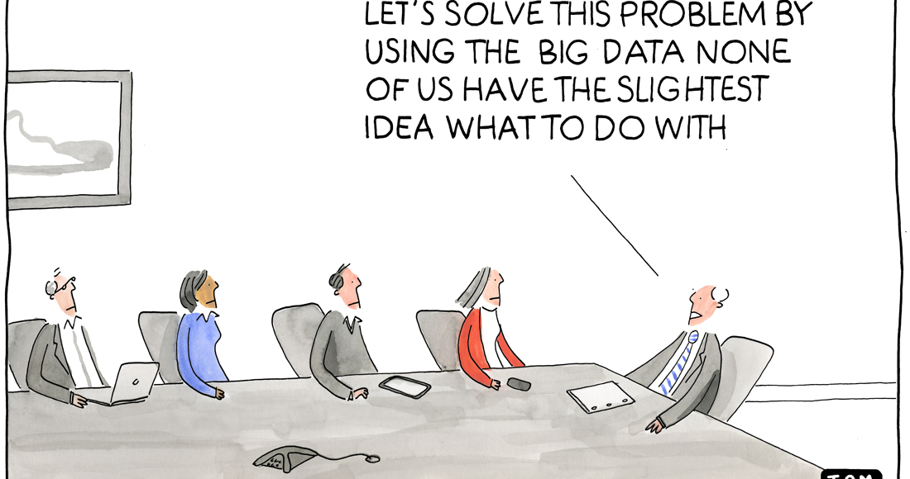

Slide 11
Big Data & Traditional Analytics
 | Traditional Analytics | Big Data
Type of Data | Formatted in rows or columns | Unstructured Formats
Volume of Data | Tens of terabytes or less | 100 terabytes to petabytes
Flow of Data | Static pool | Constant
Analysis Methods | Hypothesis-based | Machine Learning
Primary Purpose | Internal decision support | Data-based products
“Big Data at Work,” Thomas Davenport

Slide 12
Data Products
Definition
Data Products: Combining analytical capabilities and data assets to produce value added information product offerings
Linkedin Corp. -developed “People You May Know,” and soon added others, including “Jobs You May Be Interested In”
Facebook, “Look Alike” Audience
Notes:
Others, google analytics
Predictive analytics for machine repair

Slide 13

Data Products
Data products (most of which can be described as services) are not generally sold separately to customers but are used to
Attract customers for advertising
Draw attention to unknown products in large product pools
Cross-selling and upselling

Slide 14
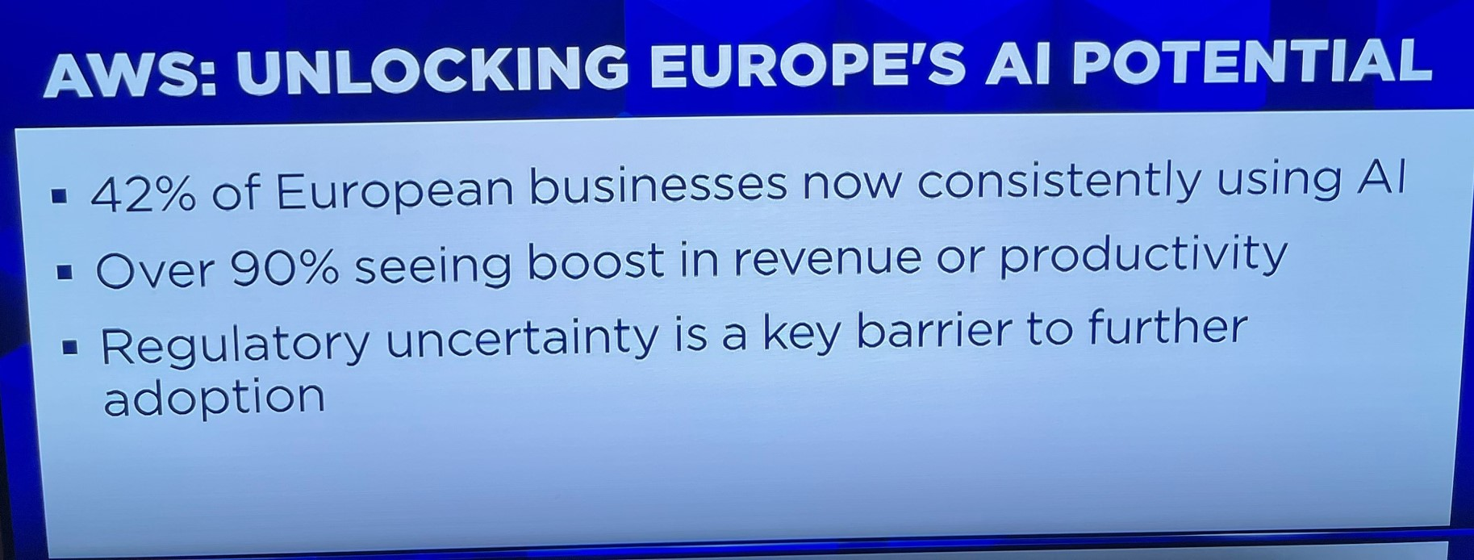
AWS Report (Feb 2025) Usage in Europe
Source Bloomberg: February 2025

Slide 15
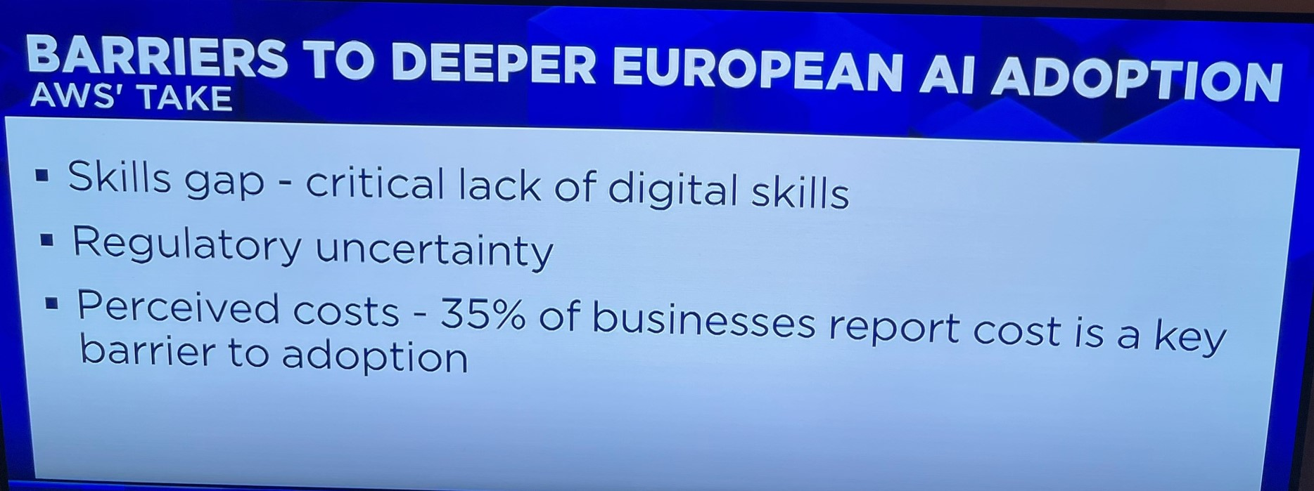
AWS Report (Feb 2025) Usage in Europe
Source Bloomberg: February 2025

Slide 16
AWS – AI in Cloud
Offers low cost infrastructure
Security
High Performance
Choice of Models
Source Bloomberg: February 2025

Slide 17
AWS – Offers Choice of LLMs
Can use Amazon Bedrock to train multiple models
-(including Deepseek)

Slide 18
AWS- Examples
BT uses Amazon’s Q product: time to write code is reduced by 12%
French Medical Device Company – uses AWS to convert Medical Documents to French Regulatory documents, used to take months, now seconds
Source Bloomberg: February 2025

Slide 19
Chip Wars
GPUs (Graphical Processing Units) was created by Nvidia in 1999.
It allows faster processing because it used matrix calculations instead of linear calculations
OpenAI’s ChatGPT was trained on a supercomputer build by Microsoft using Nvidia GPUs.
Each GPU costs upto $250,000, and Microsoft’s GPT computer contains about 10,000
Reference Investor’s Chronicle, Feb 2023
Notes:
,

Slide 20
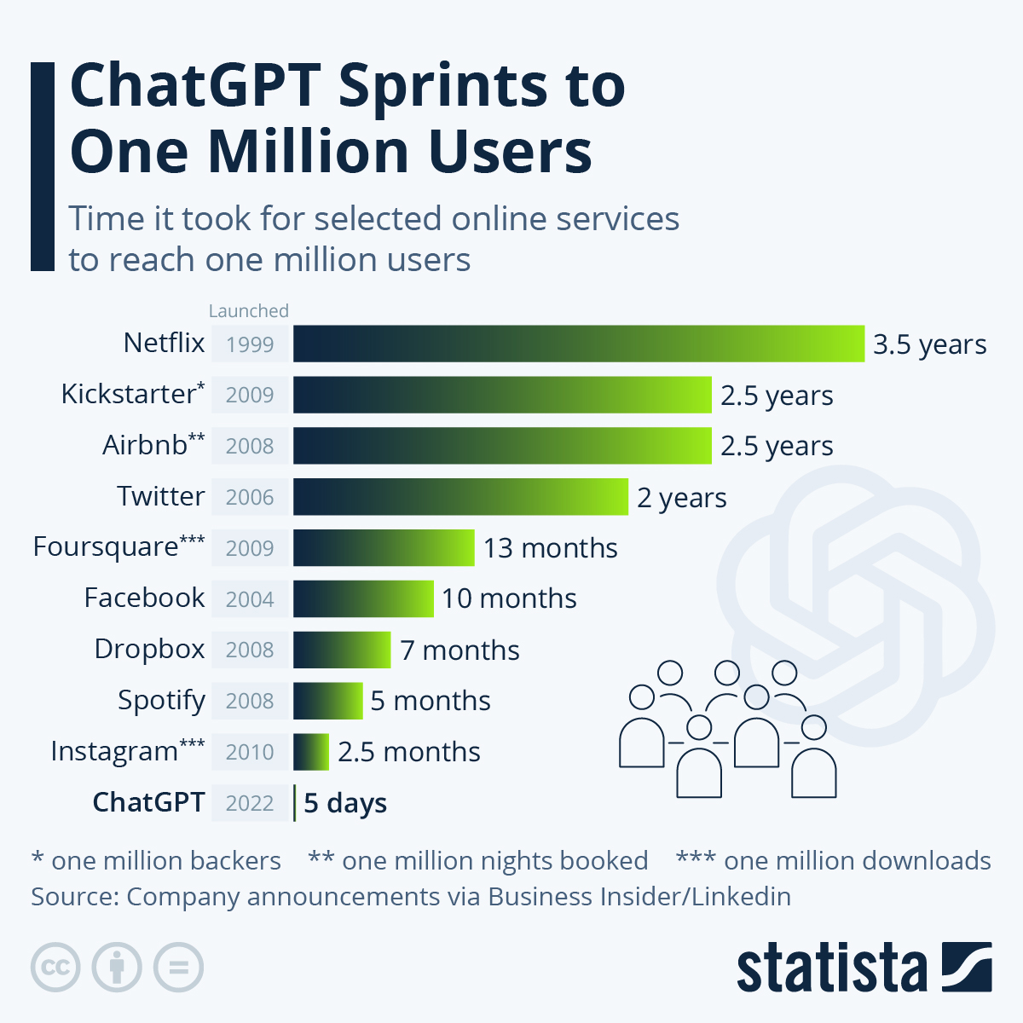

Slide 21
OpenAI was co-founded in 2015 by Elon Musk and Sam Altman and is backed by well-known investors — e.g.,Microsoft.
Since November 2022, when OpenAi, the company which makes ChatGPT, first opened the chatbot to the public, there has been little else that the tech elite has wanted to talk about.
Notes:
,

Slide 22
ChatGPT is seen as a threat to Google search?

Slide 23
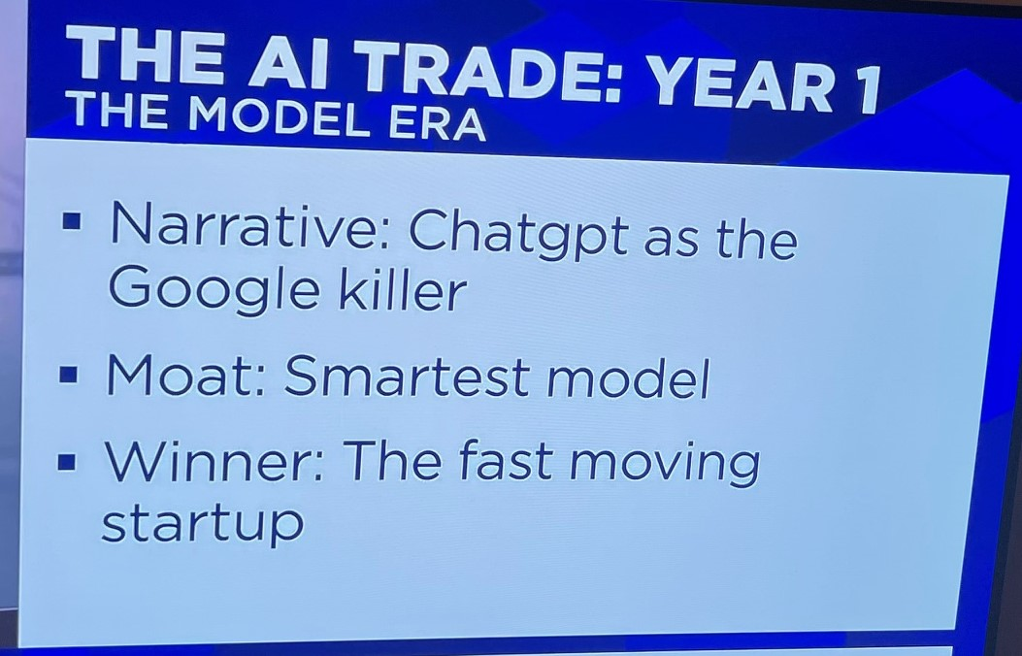
Source CNBC Dec 2025

Slide 24
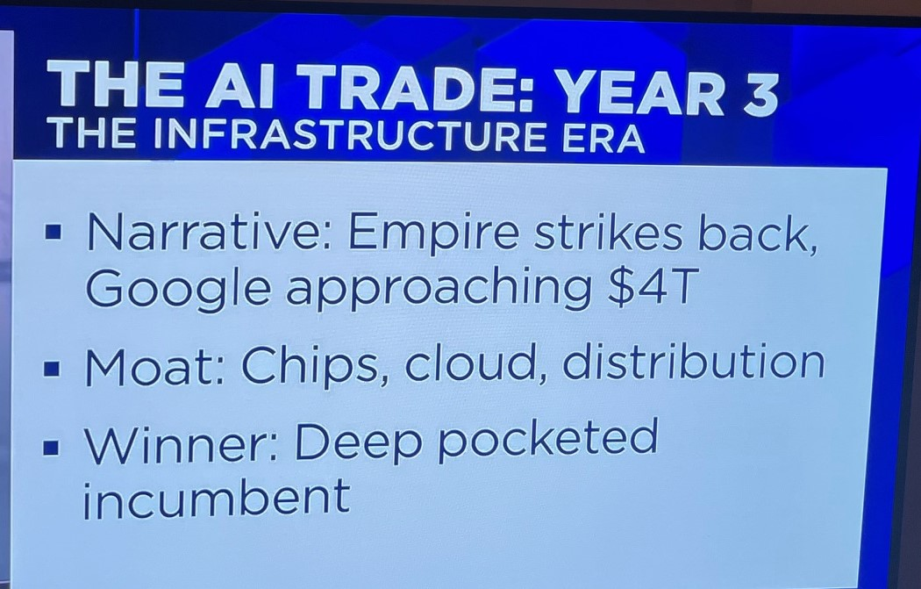
Source CNBC Dec 2025

Slide 25

January 2025: Google to invest fresh $1bln in OpenAI rival Anthropic, FT article
Anthropic -AI start-ups company
Tech titans Amazon and Alphabet have invested billions of dollars into the company.
Its AI chatbot, Claude, rivals the capabilities of ChatGPT.

Slide 26

Satya Nadella
https://www.youtube.com/watch?v=tAxQIpp4uQA

Slide 27
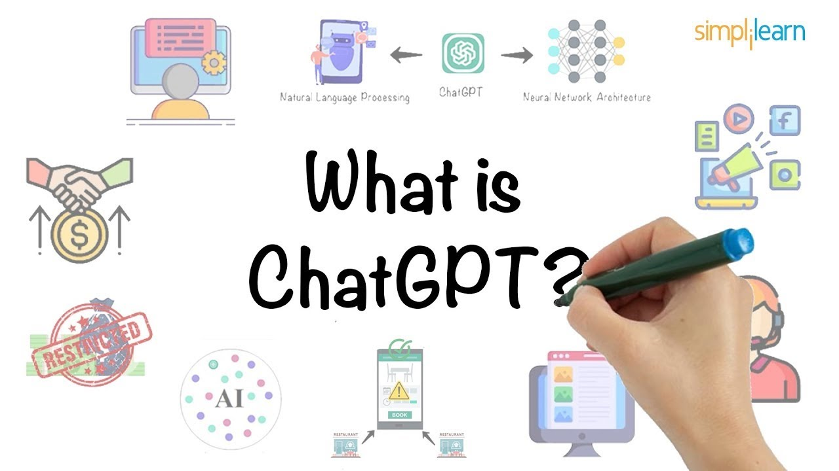

Slide 28

What is ChatGPT?
In its own description, ChatGPT is “an AI-powered chatbot developed by OpenAI, based on the GPT (Generative Pretrained Transformer) language model.
It uses deep learning techniques to generate human-like responses to text inputs in a conversational manner.”

Slide 29
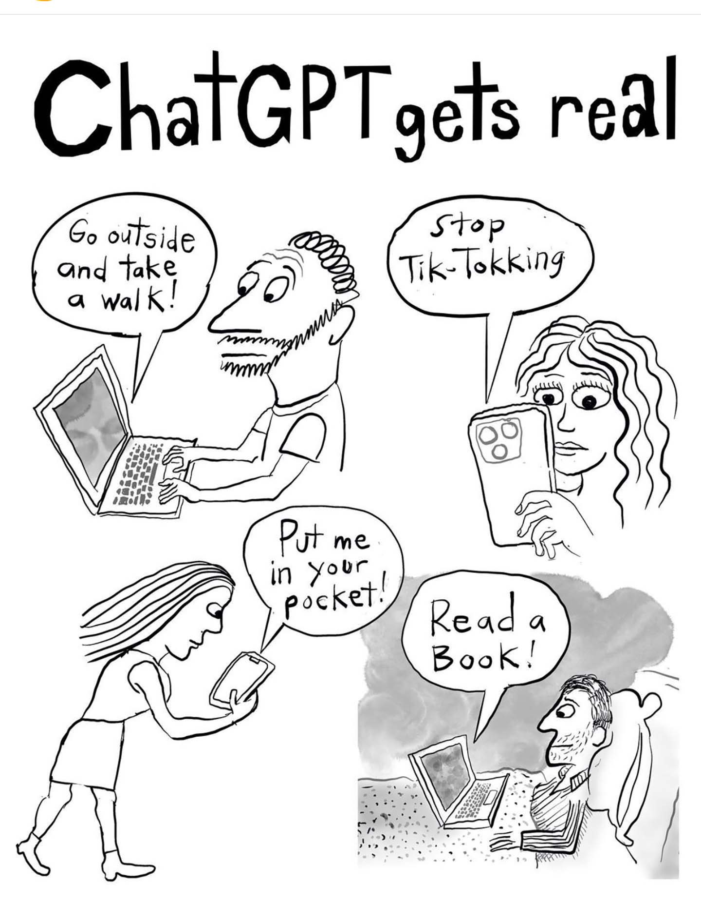
ChatGPT is powered by a large language model, or LLM, meaning it’s programmed to understand human language and generate responses based on large amount of data.
ChatGPT embodies more knowledge than any human has ever known & is one of the largest and most powerful language processing AI models to date.
ChatGPT, has aced exams that serve as gateways for people to enter careers in law and medicine in the USA
Other “generative ai” models can churn out digital photos, drawings and animations.
Notes:
It can converse cogently about mineral extraction in Papua New Guinea, or about tsmc, a Taiwanese semiconductor firm that finds itself in the geopolitical crosshairs. gpt-4, the artificial neural network which powers Chatgpt, has aced exams that serve as gateways for people to enter careers in law and medicine in America. It can generate songs, poems and essays. Other “generative ai” models can churn out digital photos, drawings and animations.
The contemporary explosion of the capabilities of ai software began in the early 2010s, when a software technique called “deep learning” became popular. Using the magic mix of vast datasets and powerful computers running neural networks on Graphics Processing Units (gpus), deep learning dramatically improved computers’ abilities to recognise images, process audio and play games. By the late 2010s computers could do many of these tasks better than any human.

Slide 30
How does it work?
First, the language of the query is converted from words, which neural networks cannot handle, into a representative set of numbers (see graphic).
(Extract from the Economist, April 2024)
Notes:
gpt-3, which powered an earlier version of Chatgpt, does this by splitting text into chunks of characters, called tokens, which commonly occur together. These tokens can be words, like “love” or “are”, affixes, like “dis” or “ised”, and punctuation, like “?”. gpt-3’s dictionary contains details of 50,257 tokens.

Slide 31
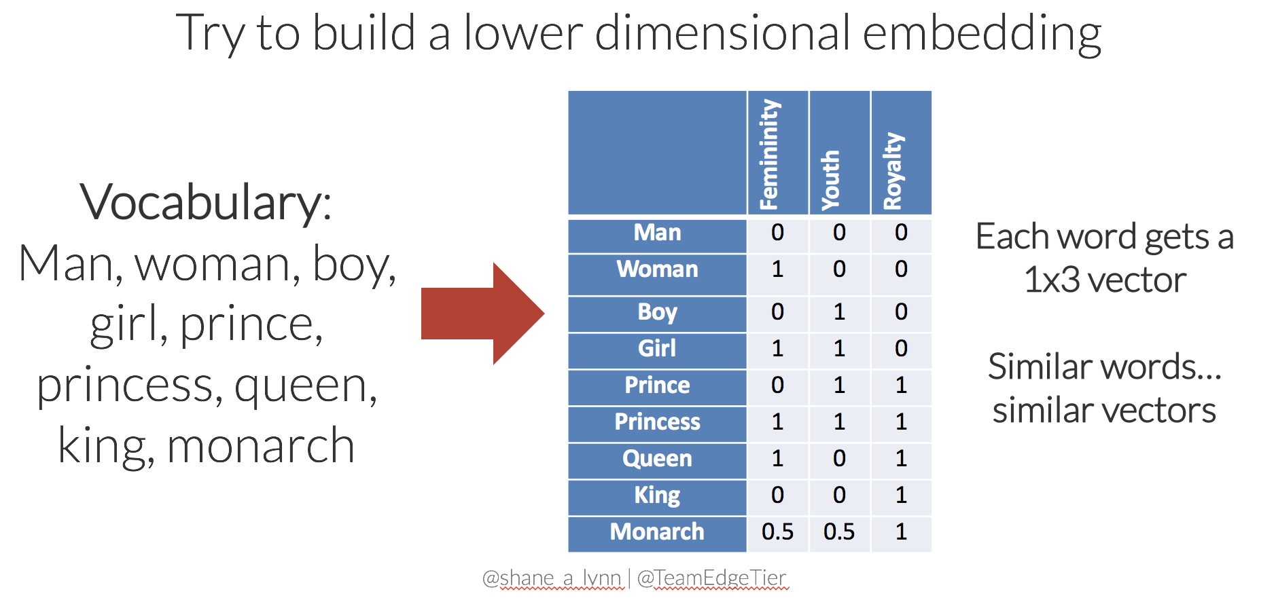
Sample of a simple model
Notes:
From “the Economist,” April 2023,
To train, the LLM quizzes itself on the text it is given. It takes a chunk, covers up some words at the end, and tries to guess what might go there. Then the LLM uncovers the answer and compares it to its guess. Because the answers are in the data itself, these models can be trained in a “self-supervised” manner on massive datasets without requiring human labellers.
The model’s goal is to make its guesses as good as possible by making as few errors as possible. Not all errors are equal, though. If the original text is “I love ice cream”, guessing “I love ice hockey” is better than “I love ice are”. How bad a guess is turned into a number called the loss. After a few guesses, the loss is sent back into the neural network and used to nudge the weights in a direction that will produce better answers.
Trailblazing a daze
The LLM’s attention network is key to learning from such vast amounts of data. It builds into the model a way to learn and use associations between words and concepts even when they appear at a distance from each other within a text, and it allows it to process reams of data in a reasonable amount of time. Many different attention networks operate in parallel within a typical LLM and this parallelisation allows the process to be run across multiple trys. Older, non-attention-based versions of language models would not have been able to process such a quantity of data in a reasonable amount of time. “Without attention, the scaling would not be computationally tractable,” says Yoshua Bengio, scientific director of Mila, a prominent AI research institute in Quebec.
The sheer scale at which LLMs can process data has been driving their recent growth. gpt-3 has hundreds of layers, billions of weights, and was trained on hundreds of billions of words. By contrast, the first version of gpt, created five years ago, was just one ten-thousandth of the size.
But there are good reasons, says Dr Bengio, to think that this growth cannot continue indefinitely. The inputs of LLMs—data, computing power, electricity, skilled labour—cost money. Training GPT-3, for example, used 1.3 gigawatt-hours of electricity (enough to power 121 homes in America for a year), and cost OpenAI an estimated $4.6m.
GPT-4, which is a much larger model, will have cost disproportionately more (in the realm of $100m) to train. Since computing-power requirements scale up dramatically faster than the input data, training LLMs gets expensive faster than it gets better. Indeed, Sam Altman, the boss of OpenAI, seems to think an inflection point has already arrived. On April 13th he told an audience at the MIT: “I think we’re at the end of the era where it’s going to be these giant models. We’ll make them better in other ways.”
But the most important limit to the continued improvement of LLMs is the amount of training data available. GPT-3 has already been trained on what amounts to all of the high-quality text that is available to download from the internet.
A paper published in October 2022 concluded that “the stock of high-quality language data will be exhausted soon; likely before 2026.” There is certainly more text available, but it is locked away in small amounts in corporate databases or on personal devices, inaccessible at the scale and low cost that Common Crawl allows.
Computers will get more powerful over time, but there is no new hardware forthcoming which offers a leap in performance as large as that which came from using GPUs in the early 2010s, so training larger models will probably be increasingly expensive—perhaps why Mr Altman is not enthused by the idea.
Improvements are possible, including new kinds of chips such as Google’s Tensor Processing Unit, but the manufacturing of chips is no longer improving exponentially through Moore’s law and shrinking circuits.
There will also be legal issues. Stability AI, a company which produces an image-generation model called Stable Diffusion, has been sued by Getty Images, a photography agency.
Stable Diffusion’s training data comes from the same place as GPT-3 and GPT-4, Common Crawl, and it processes it in very similar ways, using attention networks. Some of the most striking examples of AI’s generative prowess have been images. People on the internet are now regularly getting caught up in excitement about apparent photos of scenes that never took place: e.g., Donald Trump being arrested.
Getty points to images produced by Stable Diffusion which contain its copyright watermark, suggesting that Stable Diffusion has ingested and is reproducing copyrighted material without permission (Stability AI has not yet commented publicly on the lawsuit). The same level of evidence is harder to come by when examining ChatGPT’s text output, but there is no doubt that it has been trained on copyrighted material. OpenAI will be hoping that its text generation is covered by “fair use”, a provision in copyright law that allows limited use of copyrighted material for “transformative” purposes. That idea will probably one day be tested in court.
A major appliance
But even in a scenario where LLMs stopped improving this year, and a blockbuster lawsuit drove OpenAI to bankruptcy, the power of large language models would remain. The data and the tools to process it are widely available, even if the sheer scale achieved by OpenAI remains expensive.
Open-source implementations, when trained carefully and selectively, are already aping the performance of GPT-4. This is a good thing: having the power of LLMs in many hands means that many minds can come up with innovative new applications, improving everything from medicine to the law.
But it also means that the catastrophic risk which keeps the tech elite up at night has become more imaginable. LLMs are already incredibly powerful and have improved so quickly that many of those working on them have taken fright. The capabilities of the biggest models have outrun their creators’ understanding and control. That creates risks, of all kinds.

Slide 32
LLMs would know the grammar rules of English..
The LLM then deploys its “attention network” to make connections between different parts of the prompt.
It would be obvious to them which words relate to each other
Notes:
The llm then deploys its “attention network” to make connections between different parts of the prompt. Someone reading our prompt, “the promise of large language models is that they…”, would know how English grammar works and understand the concepts behind the words in the sentence. It would be obvious to them which words relate to each other—it is the model that is large, for example. An llm, however, must learn these associations from scratch during its training phase—over billions of training runs, its attention network slowly encodes the structure of the language it sees as numbers (called “weights”) within its neural network. If it understands language at all, an LLM only does so in a statistical, rather than a grammatical, way. It is much more like an abacus than it is like a mind.

Slide 33
Process the data
The recent success of LLMs in generating convincing text, is due to the coalescence of three things:
huge quantities of data;
algorithms capable of learning from them; and
the computational power to do so.
Notes:
Process the data
The recent success of llms in generating convincing text, as well as their startling emergent abilities, is due to the coalescence of three things: gobsmacking quantities of data, algorithms capable of learning from them and the computational power to do so (see chart).

Slide 34
Initially the weights in GPT-3’s neural network are mostly random.
As a result, the text it generates is gibberish, Then it gets trained
GPT-3 was trained on several sources of data, but the bulk of it comes from snapshots of the entire internet between 2016 and 2019 taken from a database called Common Crawl
GPT-4 (released March 2023) handles real-time and up-to-date information better, enabling it to provide more relevant responses in dynamic contexts.
GPT-4 can interpret images
GPT-4 can generate code, e.g., upload a diagram of a webpage and it will generate the HTML and CSS
Notes:
There’s a lot of junk text on the internet, so the initial 45 terabytes were filtered using a different machine-learning model to select just the high-quality text: 570 gigabytes of it, a dataset that could fit on a modern laptop. In addition, gpt-4 was trained on an unknown quantity of images, probably several terabytes. By comparison AlexNet, a neural network that reignited image-processing excitement in the 2010s, was trained on a dataset of 1.2m labelled images, a total of 126 gigabytes—less than a tenth of the size of gpt-4’s dataset.

Slide 35
ChatGPT-5
ChatGPT-5 offers substantial improvements over GPT-4, featuring superior reasoning, significantly enhanced coding (up to 74.9% accuracy) and math performance, and a 45–80% lower hallucination rate.
It supports larger context windows (400K+ tokens), enabling better analysis of long documents, and provides more personalized, emotionally intelligent, and human-like conversations.

Slide 36
Risk
There are also legal issues. Stability AI, a company which produces an image-generation model called Stable Diffusion, has been sued by Getty Images
LLMs are already incredibly powerful and have improved so quickly that many of those working on them have taken fright.
That creates risks, of all kinds.

Slide 37
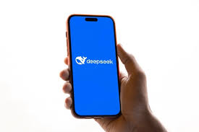
DeepSeek
January 2025: Chinese AI startup DeepSeek launched
AI models from ChatGPT to DeepSeek require advanced chips to power their training.
The USA administration has since 2021 widened the scope of bans designed to stop these chips from being exported to China and used to train Chinese firms' AI models.
Notes:
The milestone highlights how DeepSeek has left a deep impression on Silicon Valley, upending widely held views about U.S. primacy in AI

Slide 38
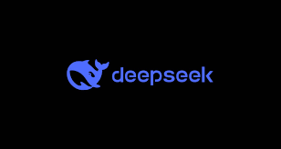
DeepSeek
DeepSeek-V3 claims it uses Nvidia's H800 chips(older than current chips) for training, spending less than $6 million.
Notes:
Although this detail has since been disputed, the claim that the chips used were less powerful than the most advanced Nvidia products Washington has sought to keep out of China, as well as the relatively cheap training costs, has prompted U.S. tech executives to question the effectiveness of tech export controls

Slide 39
1. Genuinely smarter, efficient DeepSeek AI architecture
DeepSeek-V3 is built on a mixture-of-experts (MoE) architecture, which means it doesn’t fire on all cylinders together. Instead, it activates only 37 billion of its 671 billion parameters per token, making it a leaner machine.
It is not just about saving computational power – it also handles complex tasks like advanced coding, mathematical reasoning, & nuanced problem-solving.

Slide 40
2. DeepSeek is inexpensive
DeepSeek-V3 is very affordable compared to competitors.
While OpenAI’s GPT-4 can cost up to $15 per million input tokens and $60 per million output tokens, DeepSeek-V3’s pricing is $0.14 per million input and $0.28 per million output. This is disruptive
This drastic price difference could make AI tools more accessible to smaller businesses, startups, etc

Slide 41
3. DeepSeek is open-source, free for all
While many companies keep their AI models locked up behind proprietary licenses, DeepSeek has taken a bold step by making it Open Source.
It encourages collaboration, rapid innovation, and more tailored applications.

Slide 42
4. Navigating the geopolitical tightrope
DeepSeek’s rise also reflects a bigger picture.
By creating a model that sidesteps hardware dependencies, the company is showing how innovation can flourish even in challenging circumstances.
With U.S. export restrictions limiting access to advanced chips, many predicted that Chinese AI development would face significant setbacks. Instead, companies like DeepSeek have showcased how innovation and strategic design can overcome these barriers.
This strategy has broader implications. It demonstrates how countries or companies facing technological restrictions can stay competitive through smarter design rather than sheer computational power

Slide 43
DeepSeek-V3 is a prime example of how fresh ideas and clever strategies can shake up even the most competitive industries.
By blending architectural ingenuity, cost-effectiveness, open-source accessibility, and adaptability, it’s setting a new standard for what’s possible in AI.

